Slide 1
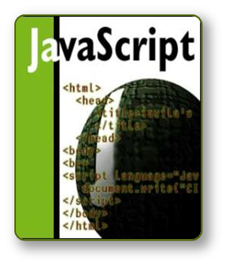


JavaScript
Dynamic Behavior in a Web Page

Slide 2
JavaScript
JavaScript is a front-end scripting language developed by Netscape for dynamic content
  Lightweight, but with limited capabilities
  Can be used as object-oriented language
Client-side technology
  Embedded in your HTML page
  Interpreted by the Web browser
Simple and flexible
Powerful to manipulate the DOM

Slide 3
JavaScript: A Language for All
JavaScript is a client-side scripting language that means a language that runs on the client side, within a web browser. If the browser supports the language, JavaScript grants access to the current page and lets the script determine properties of the client, redirect the user to another page, access cookies, and do much more………

Slide 4
LiveScript becomes JavaScript
JavaScript was originally developed by Brendan Eich of Netscape under the name Mocha, which was later renamed to LiveScript, and finally to JavaScript. LiveScript was the official name for the language when it first shipped in beta releases of Netscape Navigator 2.0 in September 1995, the changeover may have contributed more confusion to both the Java and HTML scripting worlds than anyone expected. Before the announcement, the language was already related to Java in some ways.

Slide 5
Many of the basic syntax elements of the scripting language were reminiscent of the Java style. For client-side scripting, the language was intended for very different purposes than Java—essentially to function as a programming language integrated into HTML documents rather than as a language for writing applets that occupy a fixed rectangular area on the page (and that are oblivious to anything else on the page). JavaScript had a small vocabulary and a more easily digestible programming model.

Slide 6
JavaScript is an implementation of the ECMAScript (European Computer Manufacturers Association) language standard and is typically used to enable programmatic access to computational objects within a host environment. It can be characterized as a prototype-based object-oriented scripting language that is dynamic, weakly typed and has first-class functions. It is also considered a functional programming language because it has closures and supports higher-order functions.

Slide 7
Conti……
The true difficulty, it turned out, was making the distinction between Java and JavaScript clear to the world. Many computer journalists made major blunders when they said or implied that JavaScript provided a simpler way of building Java applets. To this day, some new programmers believe JavaScript is synonymous with the Java language: They post Java queries to JavaScript-specific Internet newsgroups and mailing lists. The fact remains that client-side Java and JavaScript are more different than they are similar. The two languages employ entirely different interpreter engines to execute their lines of code.

Slide 8
JavaScript: The Right Tool for the Right Job
Knowing how to match an authoring tool to a solution-building task is an important part of being a well-rounded Web site author.
Getting your Web page to respond or react directly to user interaction with form elements (input fields, text areas, buttons, radio buttons, checkboxes, selection lists) and hyper text links:-

Slide 9
Distributing small collections of database like information and providing a friendly interface to that data.
Controlling multiple-frame navigation, plug-ins, or Java applets based on user choices in the HTML document.
Preprocessing data on the client before submission to a server Changing content and styles in modern browsers dynamically and instantly in response to user interaction.

Slide 10
When to Use JavaScript
With so many web-oriented development tools and languages at your disposal, you should focus your client-side JavaScript efforts on tasks for which they are best suited. When faced with a web application task, I look to client-side JavaScript for help with the following requirements:
Data entry validation.
Serverless CGIs.

Slide 11
Dynamic HTML interactivity.
CGI prototyping.
Offloading a busy server. If you have a highly trafficked web site, it may be beneficial to convert frequently used CGI processes to client-side JavaScript scripts. After a page is downloaded, the server is free to serve other visitors. Not only does this lighten server load, but users also experience quicker response to the application embedded in the page

Slide 12
Adding life to otherwise-dead pages. HTML by itself is pretty flat. Adding a blinking chunk of text doesn’t help much; animated GIF images more often distract from, rather than contribute to, the user experience at your site.
Creating web pages that “think.” If you let your imagination soar, you may develop new, intriguing ways to make your pages appear “smart.”
you see how (without a server CGI or database) an HTML page can “remember” when a visitor last came to the page. Then any items that have been updated since the last visit—regardless of the number of updates you’ve done to the page—are flagged for that visitor. That’s the kind of subtle, thinking web page that best displays JavaScript’s powers. By the same token, web pages and applications intended for public access should not rely exclusively on JavaScript. Make sure that your primary data is accessible to visitors who have JavaScript turned off or who use browsers that don’t interpret JavaScript. Let your scripting enhance the experience for the majority of visitors who have JavaScript-enabled browsers.

Slide 13
JavaScript is Case Sensitive
Unlike HTML, JavaScript is case sensitive - therefore watch your capitalization closely when you write JavaScript statements, create or call variables, objects and functions.

Slide 14
JavaScript Advantages
JavaScript allows interactivity such as:
  Implementing form validation
  React to user actions, e.g. handle keys
  Changing an image on moving mouse over it
  Sections of a page appearing and disappearing
  Content loading and changing dynamically
  Performing complex calculations
  Custom HTML controls, e.g. scrollable table
  Implementing AJAX functionality

Slide 15
What Can JavaScript Do?
Can handle events
Can read and write HTML elements and modify the DOM tree
Can validate form data
Can access / modify browser cookies
Can detect the user’s browser and OS
Can be used as object-oriented language
Can handle exceptions
Can perform asynchronous server calls (AJAX)

Slide 16
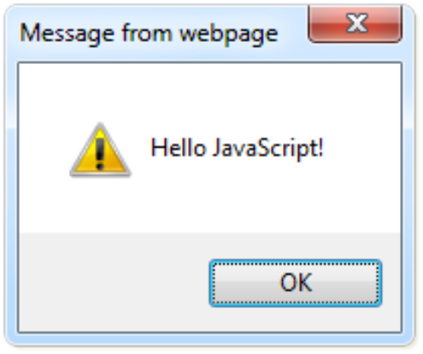
The First Script
first-script.html
<html>
<body>
<script type="text/javascript">
alert('Hello JavaScript!');
</script>
</body>
</html>

Slide 17
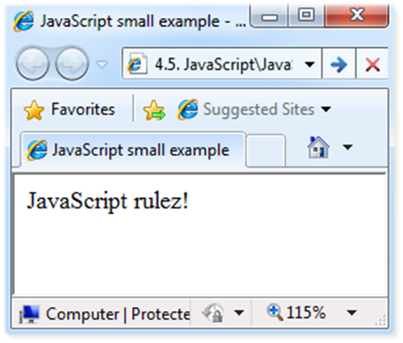
Another Small Example
small-example.html
<html>
<body>
<script type="text/javascript">
document.write('JavaScript rulez!');
</script>
</body>
</html>

Slide 18
Using JavaScript Code
The JavaScript code can be placed in:
  <script> tag in the head
  <script> tag in the body – not recommended
  External files, linked via <script> tag the head
    Files usually have .js extension
    Highly recommended
    The .js files get cached by the browser
<script src="scripts.js" type="text/javscript">
<!– code placed here will not be executed! -->
</script>

Slide 19
JavaScript – When is Executed?
JavaScript code is executed during the page loading or when the browser fires an event
  All statements are executed at page loading
  Some statements just define functions that can be called later
Function calls or code can be attached as "event handlers" via tag attributes
  Executed when the event is fired by the browser
<img src="logo.gif" onclick="alert('clicked!')" />

Slide 20
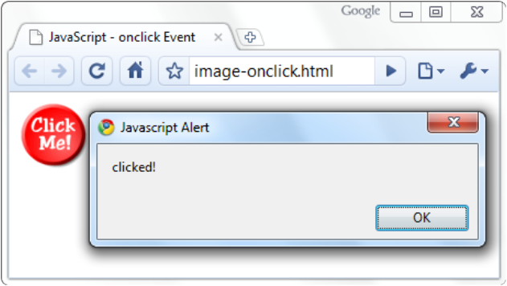
Calling a JavaScript Function from Event Handler – Example
<html>
<head>
<script type="text/javascript">
function test (message) {
alert(message);
}
</script>
</head>
<body>
<img src="logo.gif"
onclick="test('clicked!')" />
</body>
</html>
image-onclick.html

Slide 21
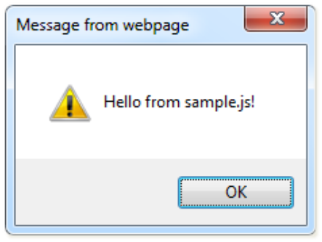
Using External Script Files
Using external script files:
External JavaScript file:
<html>
<head>
<script src="sample.js" type="text/javascript">
</script>
</head>
<body>
<button onclick="sample()" value="Call JavaScript
function from sample.js" />
</body>
</html>
external-JavaScript.html
The <script> tag is always empty.
function sample() {
alert('Hello from sample.js!')
}
sample.js

Slide 22
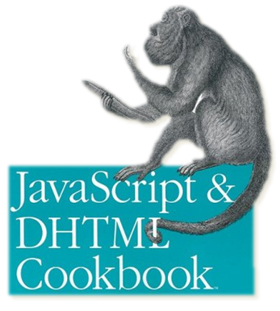
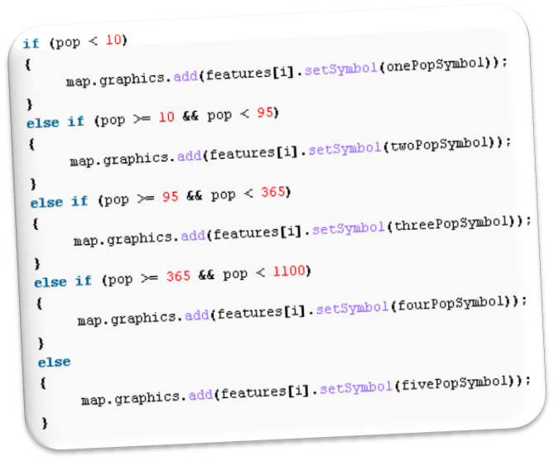
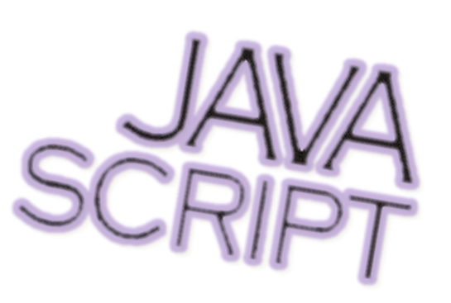
The JavaScript Syntax

Slide 23
JavaScript Syntax
The JavaScript syntax is similar to C# and Java
  Operators (+, *, =, !=, &&, ++, …)
  Variables (typeless)
  Conditional statements (if, else)
  Loops (for, while)
  Arrays (my_array[]) and associative arrays (my_array['abc'])
  Functions (can return value)
  Function variables (like the C# delegates)

Slide 24
Data Types
JavaScript data types:
  Numbers (integer, floating-point)
  Boolean (true / false)
String type – string of characters
Arrays
Associative arrays (hash tables)
var myName = "You can use both single or double quotes for strings";
var my_array = [1, 5.3, "aaa"];
var my_hash = {a:2, b:3, c:"text"};

Slide 25
Everything is Object
Every variable can be considered as object
  For example strings and arrays have member functions:
objects.html
var test = "some string";
alert(test[7]); // shows letter 'r'
alert(test.charAt(5)); // shows letter 's'
alert("test".charAt(1)); //shows letter 'e'
alert("test".substring(1,3)); //shows 'es'
var arr = [1,3,4];
alert (arr.length); // shows 3
arr.push(7); // appends 7 to end of array
alert (arr[3]); // shows 7

Slide 26
String Operations
The + operator joins strings
What is "9" + 9?
Converting string to number:
string1 = "fat ";
string2 = "cats";
alert(string1 + string2); // fat cats
alert("9" + 9); // 99
alert(parseInt("9") + 9); // 18

Slide 27
Arrays Operations and Properties
Declaring new empty array:
Declaring an array holding few elements:
Appending an element / getting the last element:
Reading the number of elements (array length):
Finding element's index in the array:
var arr = new Array();
var arr = [1, 2, 3, 4, 5];
arr.push(3);
var element = arr.pop();
arr.length;
arr.indexOf(1);

Slide 28
Standard Popup Boxes
Alert box with text and [OK] button
  Just a message shown in a dialog box:
Confirmation box
  Contains text, [OK] button and [Cancel] button:
Prompt box
  Contains text, input field with default value:
alert("Some text here");
confirm("Are you sure?");
prompt ("enter amount", 10);

Slide 29
Sum of Numbers – Example
  sum-of-numbers.html
<html>
<head>
<title>JavaScript Demo</title>
<script type="text/javascript">
function calcSum() {
value1 =
parseInt(document.mainForm.textBox1.value);
value2 =
parseInt(document.mainForm.textBox2.value);
sum = value1 + value2;
document.mainForm.textBoxSum.value = sum;
}
</script>
</head>

Slide 30
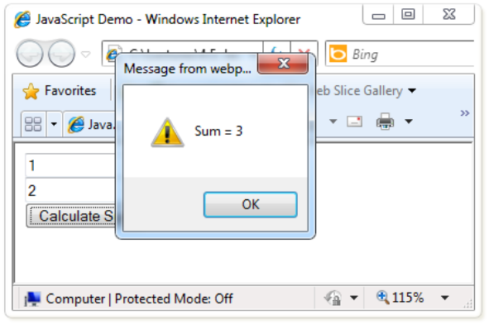
Sum of Numbers – Example (2)
  sum-of-numbers.html (cont.)
<body>
<form name="mainForm">
<input type="text" name="textBox1" /> <br/>
<input type="text" name="textBox2" /> <br/>
<input type="button" value="Process"
onclick="javascript: calcSum()" />
<input type="text" name="textBoxSum"
readonly="readonly"/>
</form>
</body>
</html>

Slide 31
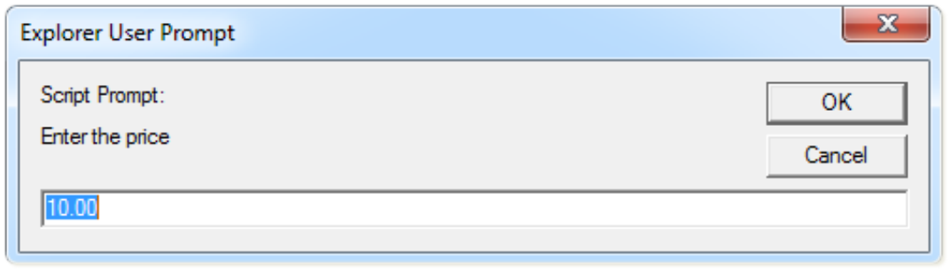
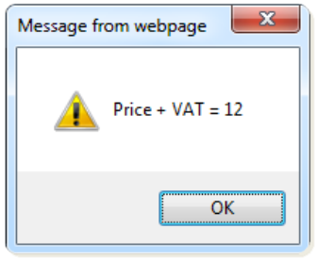
JavaScript Prompt – Example
prompt.html
price = prompt("Enter the price", "10.00");
alert('Price + VAT = ' + price * 1.2);

